Slide 1
Problem Statement

Slide 2
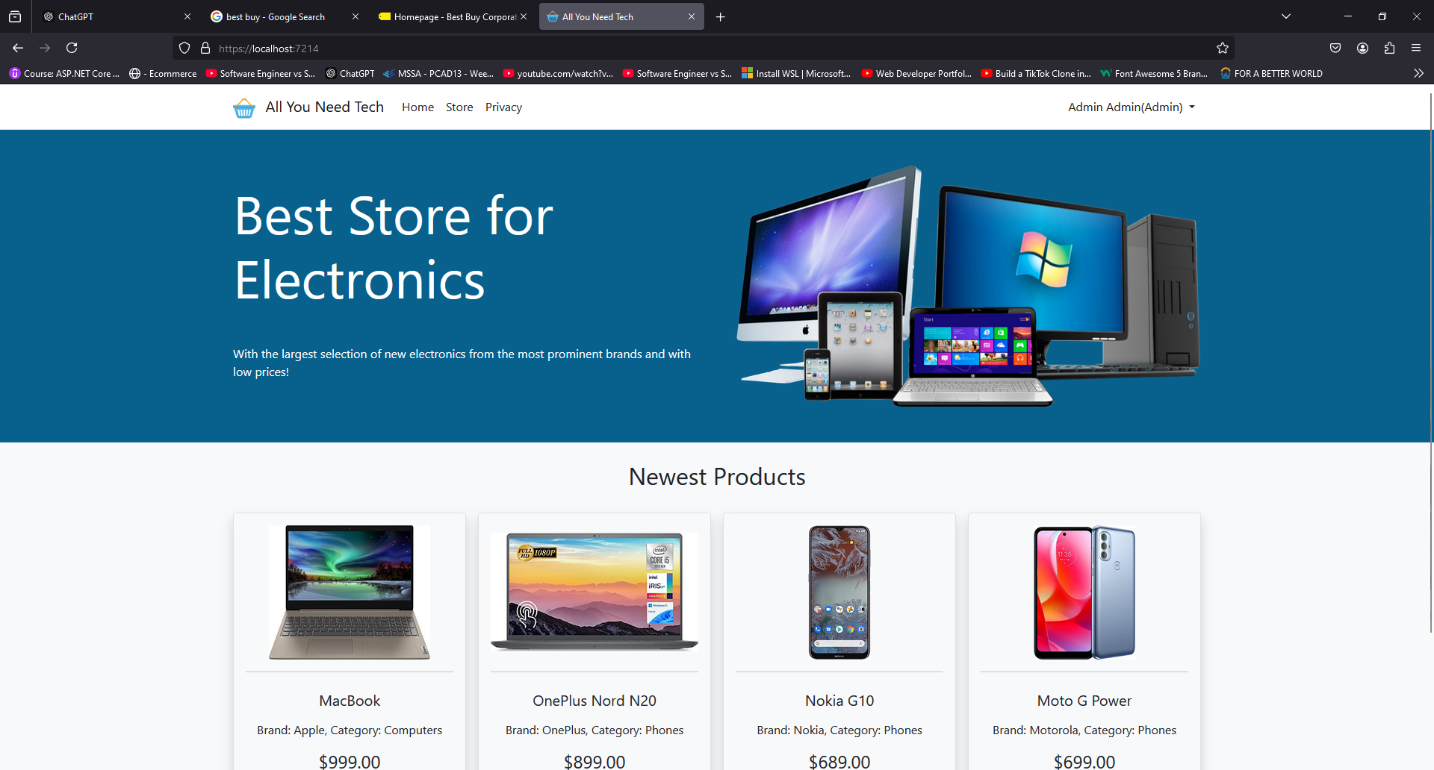
Solution

Slide 3
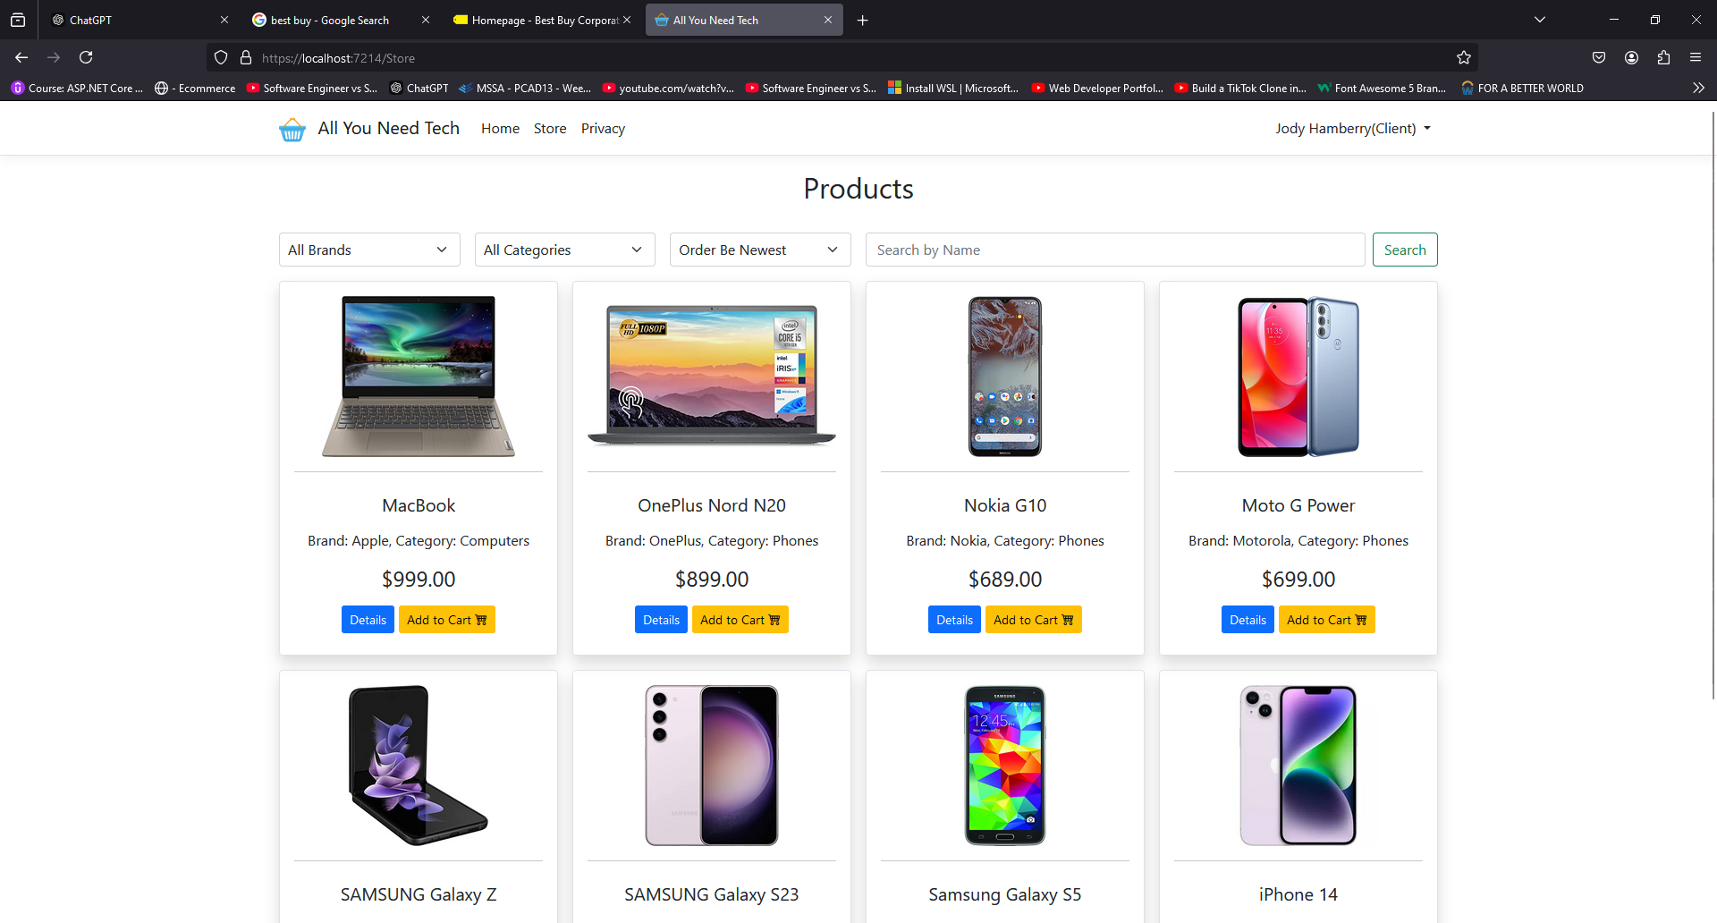
User Interface

Slide 4
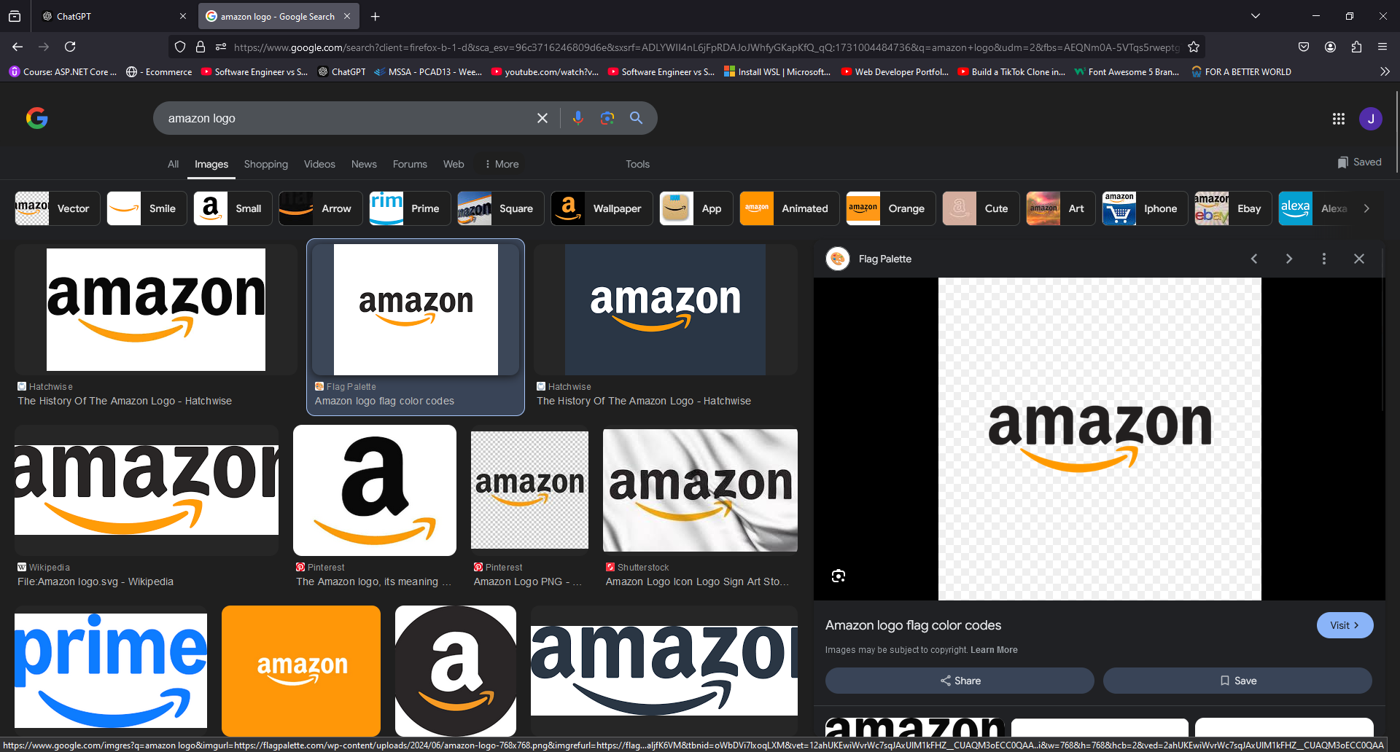
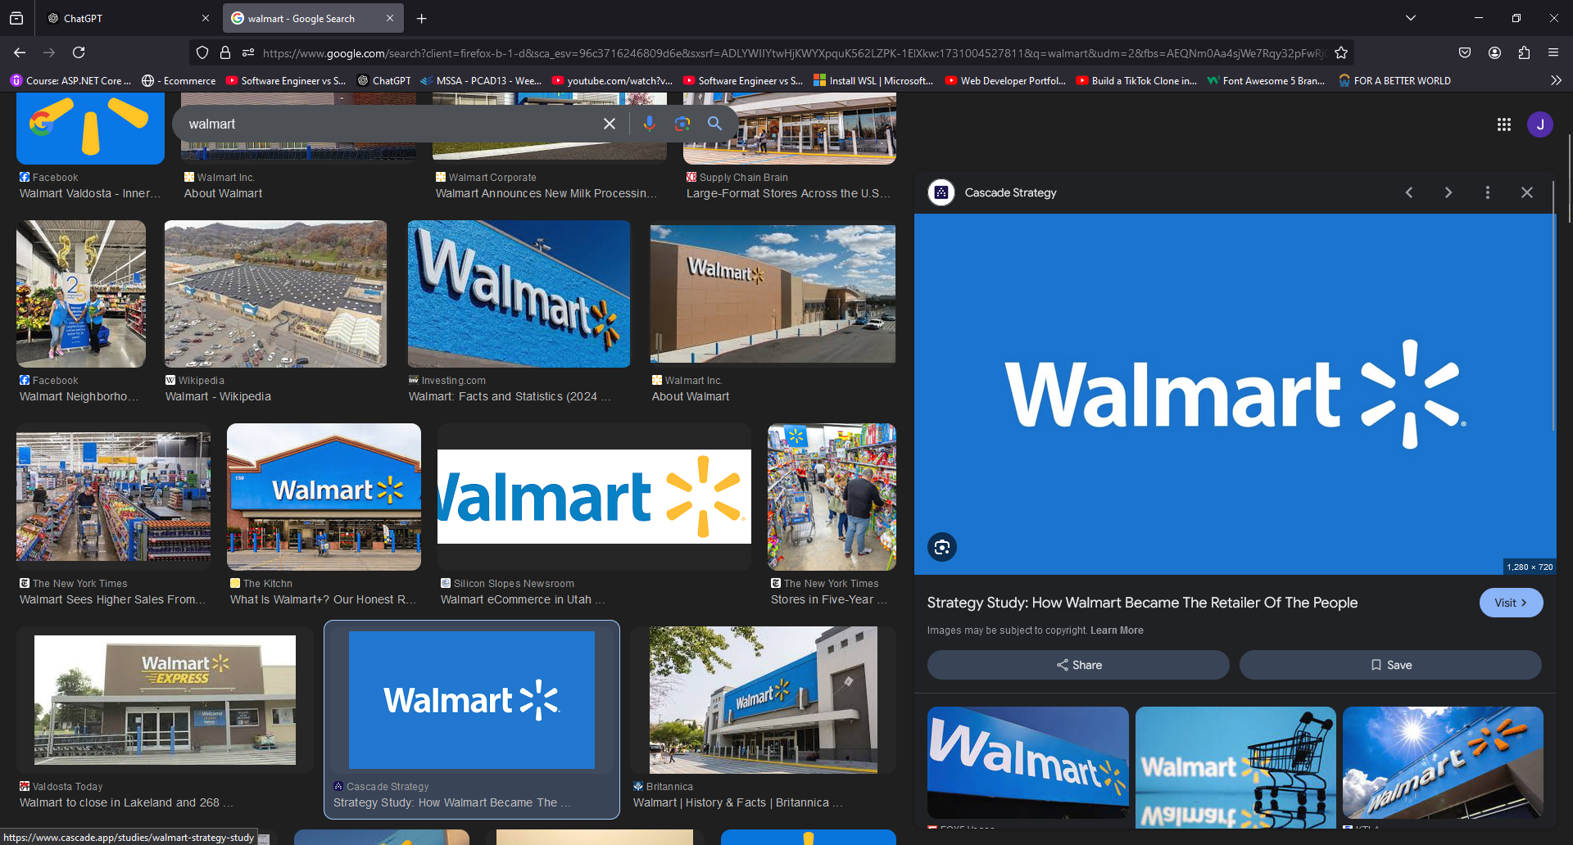
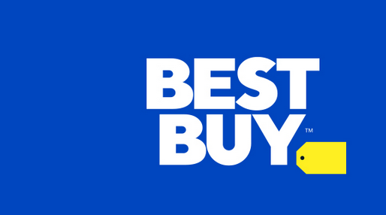
Competition

Slide 5
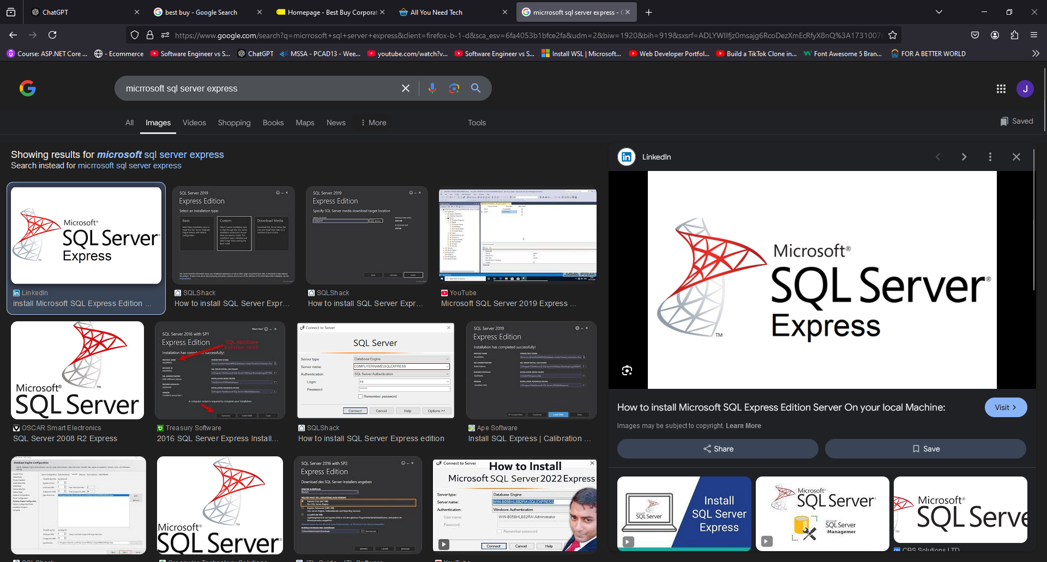
Database

Slide 6
Tools & Architecture
C#(Front & Back End)
HtmL/CSS/JS/Bootstrap(front end & styling)
ASP.Net Core (Framework)
Entity Framework (for ORM)
MODel View controller (Architecture)
Model(DB models)
View ( Front End presented to user(CSHTML))
Controller ( for this project: Provides MVC Based web app server rendering)
5. Microsoft Asp.Net Core Identity(User Auth)
6. HTTPpost(Server side rendering(front end) ) from Asp.NetCore Mvc library

Slide 7
Challenges Faced
the delineation between Microsoft SQL Server Developer edition and Microsoft SQL Express production version was challenging(downloaded and was managing both)
losing visual of current DB(needed to retrieve it from the U/I in visual studio)
slow DB load times causing application to timeout.
Typos: misspelling asp helper tags: Put “aspform” instead of “asp-for” for the asp helper tags in the cshtml file and it wouldn’t display info in the bootstrap modal that I was trying to display. It still wouldn’t work after these adjustments. Also forgot to pass profile data transfer object(temp class) to view →return View(profileDto);
Error: app http server wouldn’t load→ restart computer/fixed
database data wouldn’t load said “login issue to DB” → restart sql DB and fixed this
image wouldn’t show next to paragraph for details → I accidently commented in html incorrectly(forgot a “-“ Incorrect: <!---> correct: <!----> and this in turn threw off the display
bootstrap arrows wont show → used html code to display arrows instead. No fix

Slide 8
Purpose of the project

Slide 9
Improvements
Rest framework using javascript (Async Programming) instead of server side rendering
More robust authentication
Possible payments implementation
Finish CRUD
More visually appealing u/I
AWS Deployment & scaling

